Slide 1


HUMANIZING AI AND THE ROLE OF DATA
Deepa Naik
Co-Founder, Cogitari
Founding Member and India Lead, Humans For AI
16th March 2019

Slide 2
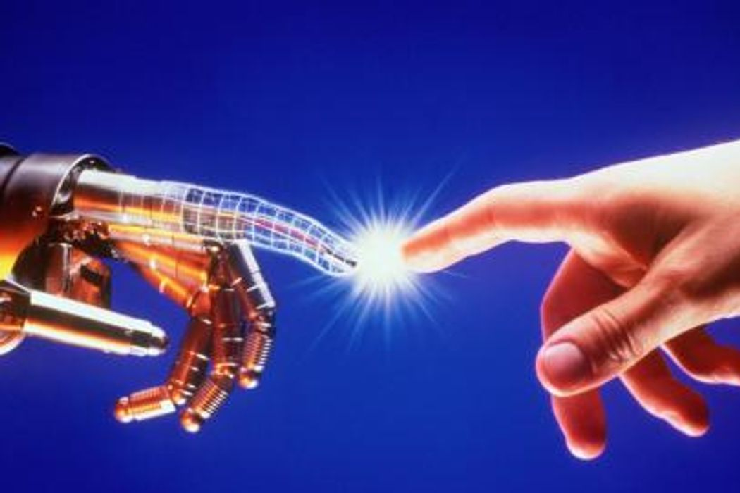

Research , Consulting & Advisory Services
Towards Building Emotional Machines

Slide 3


Humans for AI
We are on a mission to build a more diverse workforce for leveraging AI technologies

Slide 4

Celebrate Womanhood!

Slide 5
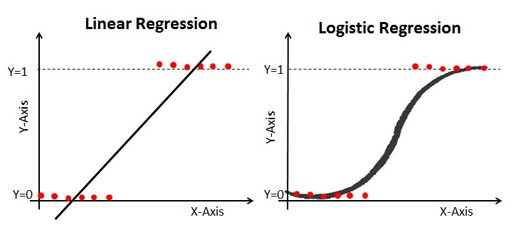
Career Path – Men vs. Women
“Men careers take a linear regression,
Women end up typically into a logistic curve”

Slide 6
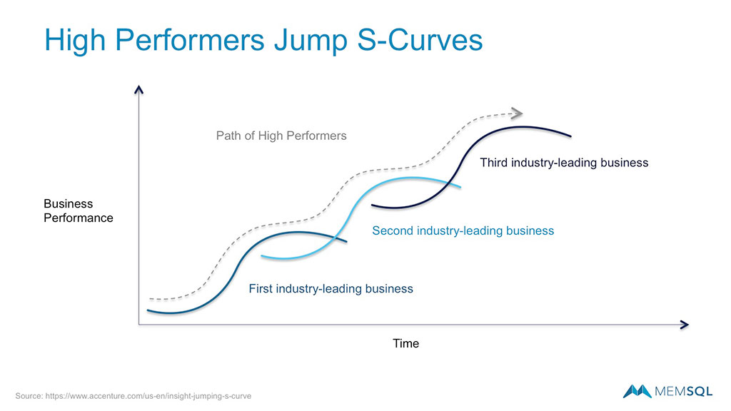
Time to Re-invent Yourself!!

Slide 7
HUMANIZING AI AND THE ROLE OF DATA

Slide 8
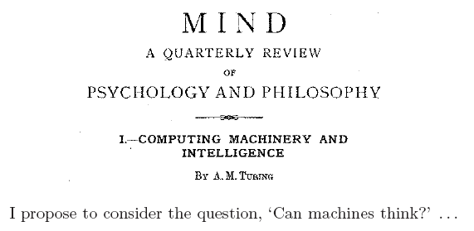
What is AI ? – A Brief History
The history of AI begins with the following articles: Turing, A.M. (1950), Computing machinery and intelligence, Mind, Vol. 59

Slide 9
What is AI – Brief History ?
The term artificial intelligence was first coined by John McCarthy in 1956
Machine Learning became popular in the 1990s

Slide 10
WHAT IS ARTIFICIAL INTELLIGENCE AND MACHINE LEARNING?
“If AI is a rocket,
the engine is algorithms and
the fuel is the database.
– Matthew Grob, CTO, Qualcomm”

Slide 11
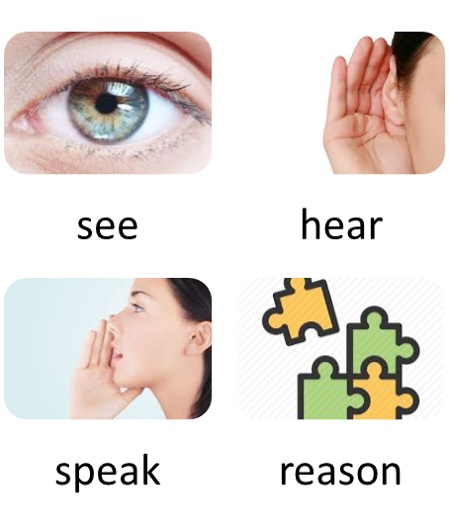
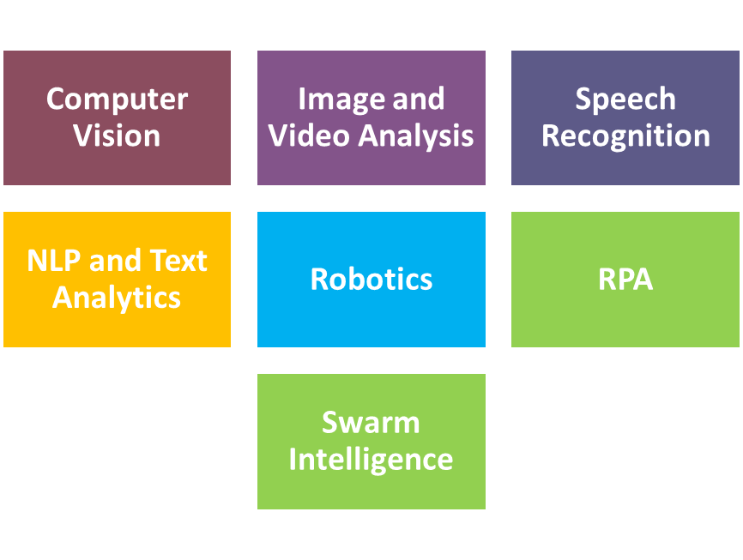
A simple definition of AI is
“The capability of a machine to imitate intelligent human behaviour”

Slide 12
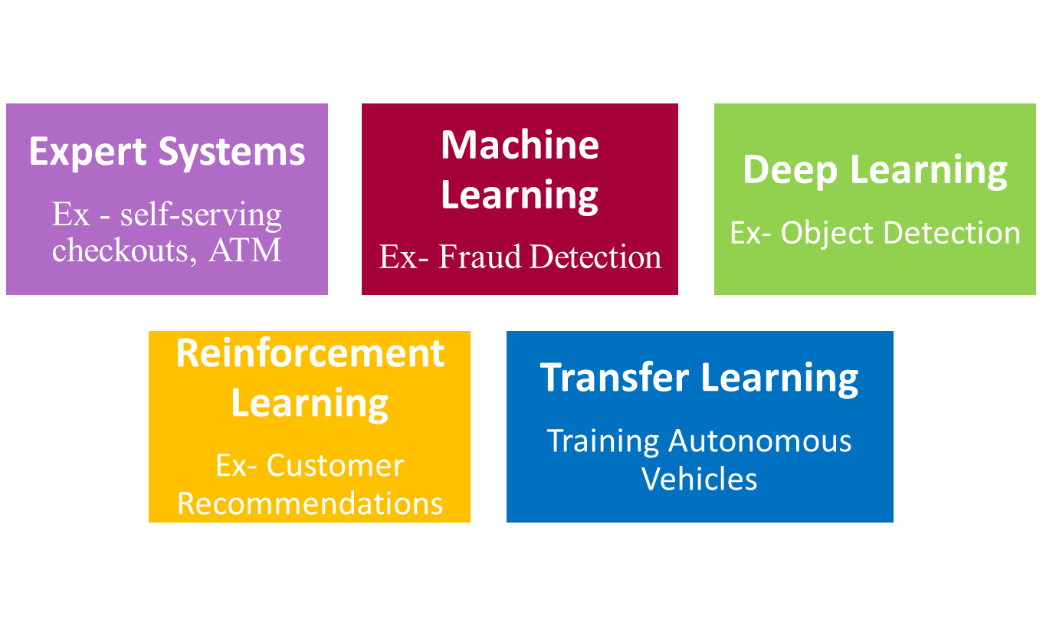
AI based on Approaches of Learning
Notes:
Expert Systems — algorithms that apply a series of if-then rules to make sense of structured inputs, in the manner of a linear decision trees
Example: self-serving checkouts, ATMs.
● Machine Learning — Algorithms that learn underlying statistical patterns from training data (often labeled), leading to an ability to make predictions for novel data.
Example: Workforce Recruitment, Fraud detection
● Deep Learning — A type of machine learning algorithm, an “artificial neural network” with many layers through which data passes to spot sophisticated patterns.
Example: Translation, Health Diagnosis
● Reinforcement Learning — Programming Approach that uses the feedback mechanism to improve algorithms.
Example: Chatbots, Customer Recommendations
● Transfer Learning — Programming approach that reuses the knowledge underpinning an algorithm in one domain to develop algorithms in another.
Example: Training Autonomous Vehicles, Natural Language Processing

Slide 13
HUMANIZING AI – EMOTION TECHNOLOGY

Slide 14
HUMANIZING AI
“To build a stronger partnership between humans and machines, it is vital to move away from a world where humans have to understand machines
to a world where the machines understand us, answering (and behaving) in the way a human would do” ​

Slide 15
What is Humanizing AI?
Humanizing AI means
integrating emotions into the ecosystem
aligning emotional intelligence, i.e. the Emotional Quotient (EQ) with normal intelligence (problem solving), i.e. Intelligent Quotient (IQ)

Slide 16
Emotion Technology / EmotionAI
Artificial emotional intelligence or Emotion AI is an area of emotion recognition or emotion detection technology which uses non-verbal cues, such as facial expressions, gesture, body language and tone of voice, to identify their emotions .
Other emotional technology includes and is not just limited to detection but also emulation , inducing the right set of emotions, measurement of emotional response and other related research areas.

Slide 17
THE ROLE OF DATA
“We're entering a new world in which data may be more important than software. “
- Tim O'Reilly

Slide 18
Automatic Emotion Recognition
Affective Facial Expression Analysis
Affective Gesture Analysis
Using Natural Language Dialogue
Physiological Signals
  using biosensors like heart rate variability (HRV), skin conductance (GSR), skin temperature, respiration, body volume pulse (BVP), and brain waves (EEG)
Reading emotions from mouse cursor movements

Slide 19
COGITARI RESEARCH

Slide 20













Machine Channels
Emotions

Slide 21
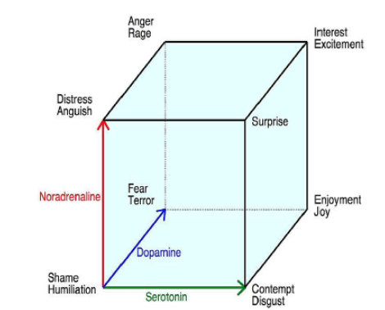
EMOTIONS AXES
(LOVEHEIM,2012)

Slide 22
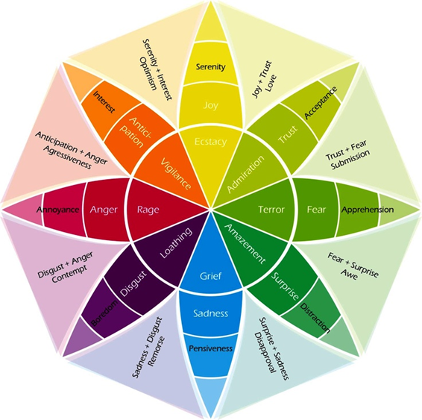
PLUTCHIK'S EMOTIONS MODEL

Slide 23
Research Implications
This study empirically, scientifically and conclusively prove that “human emotions do get impacted/stimulated based on the interactions with machine channels”. Thus it provided much needed insights into human emotions stimulated by machine interactions
With advent of Artificial Intelligence, machines are getting benefited by cognitive abilities. To emulate human abilities, in addition to cognitive functions, it is imperative that machine should become emotionally intelligent as well.

Slide 24
THE ROAD AHEAD ….

Slide 25
Thank you
Email:
Deepa.Naik@cogitari.in
Connect:
https://www.linkedin.com/in/deepa-naik/
Follow:
https://www.linkedin.com/company/cogitari

